Slide 1
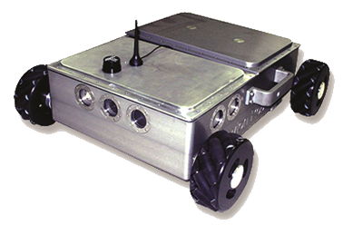
Delivering Advanced Inspection Solutions

Slide 2
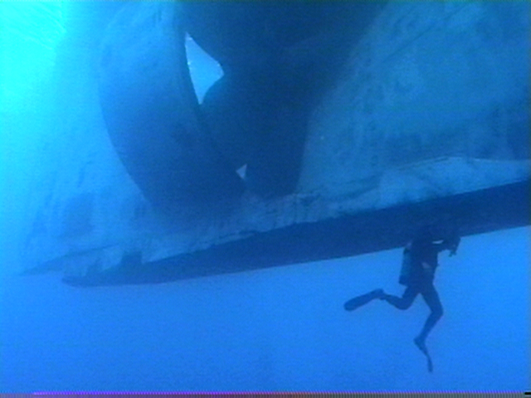
Ship inspection in water can be arduous and produces little data other than subjective interpretation from a diver

Slide 3
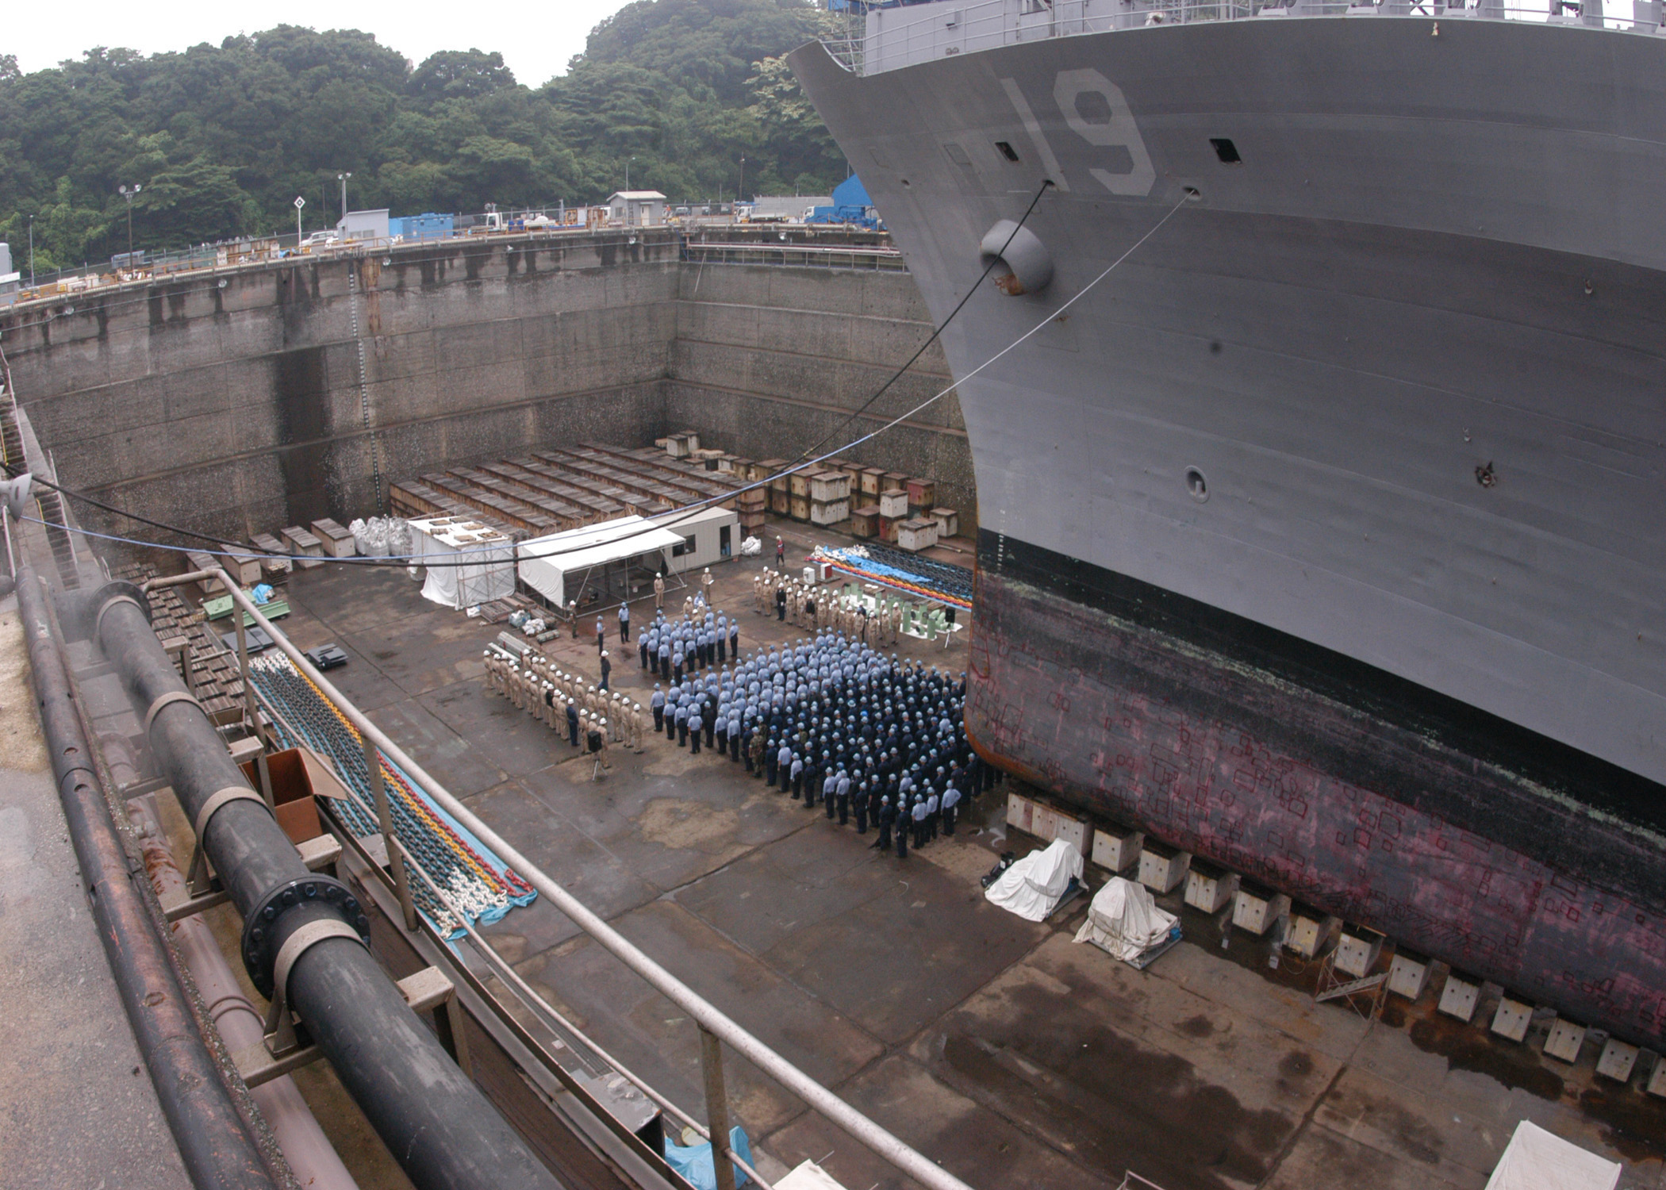
Inspecting in dry dock is timely and expensive while the ship is out of service

Slide 4
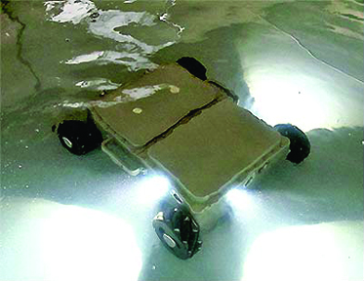
The Newton Labs’ Surveyor Underwater Inspection Robot will inspect in-service vessels, delivering complete coverage while eliminating the need for dry docking

Slide 5
Click image to begin video

Slide 6
Surveyor Data Gathering Robot
Robotic delivery platform for inspection sensors.
Built in Newton Labs Underwater Laser Scanner Technology
Optical inspection
Easily add additional sensors
Magnetic allows verticality
Battery Operable
Deployable underwater and in-air
Wet or Dry Surface Measuring Robot

Slide 7
Robotic Delivery of Underwater Laser Scanning Technology
Underwater laser scanner technology by Newton Labs captures as-built measurements with sub-millimeter precision, as well as being able to quantify rust, wear, fissures, corrosion, cracks, welds, pitting and other deformities.
Newton laser scanning is based on projecting a controlled beam of light onto a surface and determine geometrically how the light is reflected light back, both in air or underwater.
Laser scanning produces a point cloud so dense that when utilized with industry standard 3D software, a fully measurable CAD model of a scanned area can be generated

Slide 8
The Surveyor will take scan passes attached to the side of the ship
Location can be tracked by ship welds and with on board positioning system.
Additional measuring sensors such as ultra sonic can be added for further evaluation.
Surface map will allow damaged areas to be easily relocated for repair.

Slide 9
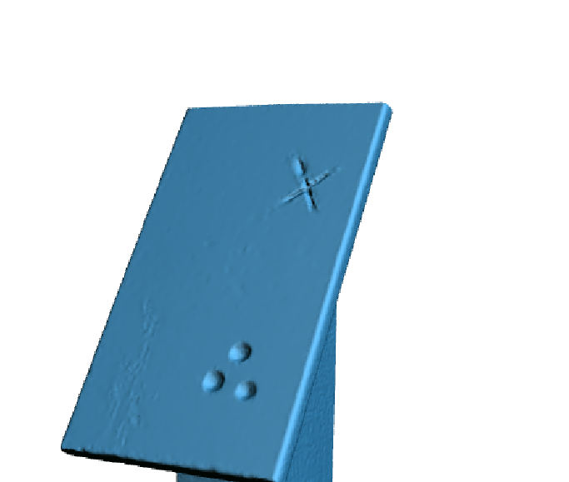
Detect and Measure Surface Distortions and Dimensions
Scanner photograph of object before scan. Bottom left corner shows surface abrasion, bottom right shows divots and the top right simulates a crack
Scan Data of same object
CAD model generated in GeoMagic using scanned data

Slide 10
Data Output
Identify pitting and surface abnormalities directly in the data output

Slide 11
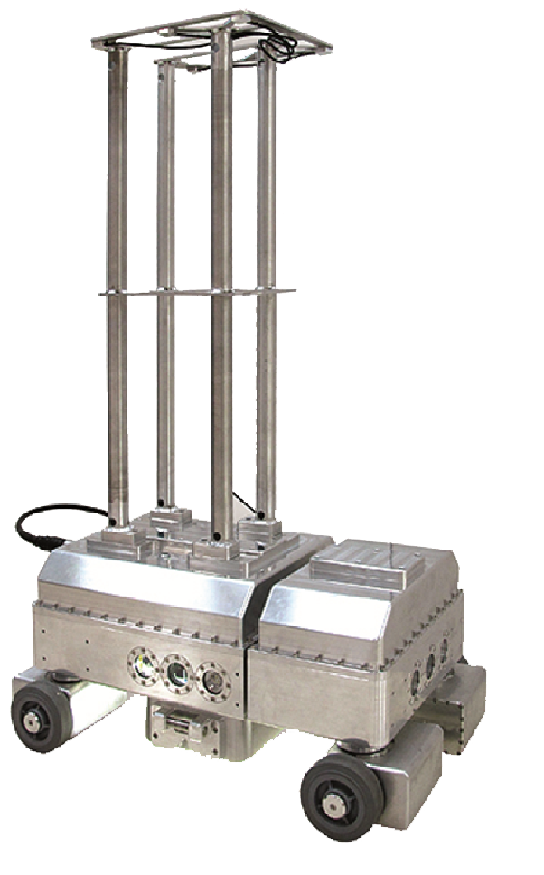
Similar Deployments: Inspector Robot
Underwater robotic platform onto which operators can attach, convey and precisely position on a variety of measuring instruments or repair tools that are used in the evaluation and maintenance of liquid storage tank floors.

Slide 12
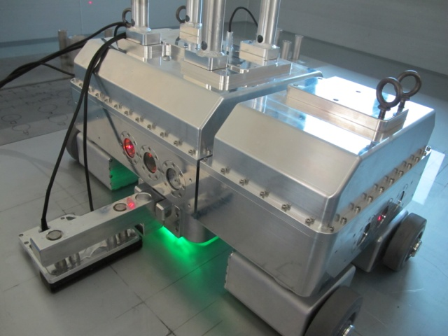
Inspector Robot
Combines multiple inspection technologies
Optical
Eddy Current
Ultrasonic
Laser Scanning
Precision Navigation-Locates damaged areas and returns to that location within 3.25 mm (1/8”) with overhead precision navigation system
Maps all damaged areas to either a tank wide map, a plate wide map or both
• Highly maneuverable four-wheel steering
• Four wheel independent drive motor system
• On-board downward-facing 3D laser scanner
• Split chassis design provides constant all-wheel contact
• Laser range finders on all four side for precise positioning

Slide 13
Newton specializes in
the combination of
machine vision and robotics,
designing and manufacturing
machines that can see
and make decisions

Slide 14
History of Newton Labs
Established in Cambridge, Massachusetts in 1990 as an offshoot of MIT; moved to Seattle in 1995.
Specializes in machine vision and robotics with an emphasis on automation combining machine vision with mechanics and electronics.
Services a wide variety of industries, focusing on applications where the introduction of machine vision to robots and automation can provide powerful new functionalities not previously available. Many of Newton’s projects are the first of a kind in the world.
Designs and manufactures all of its own machine vision and robotics software and virtually all of its own hardware, including controllers, cameras, lighting, electronics, machine control and mechanics.
More than 20,000 Newton systems are deployed worldwide.

Slide 15
Contact Information
Newton Labs
441 SW 41st Street
Renton, WA 98057 USA
Tel: 425-251-9600
Fax: 425-251-8900
www.newtonlabs.com

